Slide 1
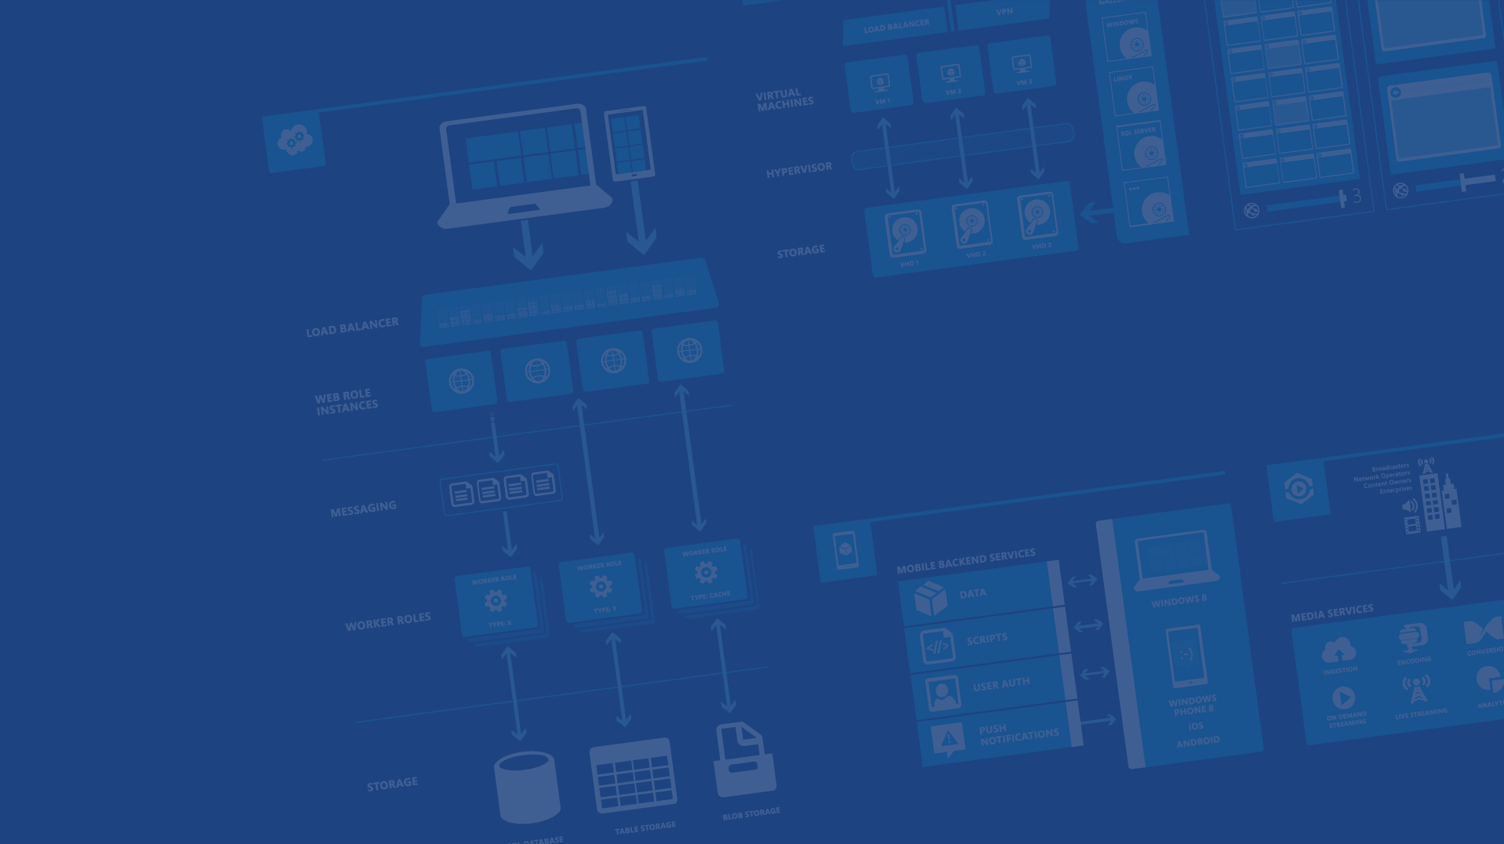
Azure Websites
Marc Gagne
Startup Lead & Sr. Technical Evangelist – Microsoft Canada
@marc_gagne - marc.gagne@microsoft.com

Slide 2
Agenda
Site creation
Language Support
Deployment
Source Control Integration
Scale
Web Jobs
Site Slots
Traffic Manager
Backup
Hybrid Connections
Other PaaS Services

Slide 3
The cloud?
Hosting models
On Premises / Colo
Infrastructure
(as a Service)
Platform
(as a Service)
Applications
Applications
You manage
Applications
You scale, make
resilient & manage
You scale, make resilient and manage
Data
Data
Data
Runtime
Runtime
Runtime
Middleware
Middleware
Middleware
Scale, resilience and management by vendor
O/S
O/S
O/S
Virtualization
Virtualization
Managed by vendor
Virtualization
Servers
Servers
Servers
Storage
Storage
Storage
Networking
Networking
Networking

Slide 4

Develop apps with…
.NET
Python
Node.js
Java
PHP

Slide 5

Choose your own (deployment) Adventure!
Visual Studio
Online
CodePlex
Git
GitHub
BitBucket
DropBox
FTP
Notes:
Slide Objectives:
Objective #1
Transition:
Transition statement(s) to setup the slide
Speaking Points:
Speaking Point #1
Speaking Point #2
Notes:
Any notes go here

Slide 6
Demo
Azure Website Creation
Notes:
Demos\001 - Azure Websites Creation\portal-overview.html
Demos\001 - Azure Websites Creation\wordpress-demo.html
Demos\001 - Azure Websites Creation\ftp-demo.html
Demos\002 - Node.js, Git & Azure Websites\node-git-azure-websites.md

Slide 7
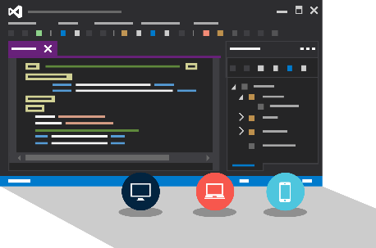
Visual Studio + Azure Websites
Create Azure Resources during File / New
Create Azure Website during deploy
Manage with Server Explorer

Slide 8
Demo
Visual Studio Support
Notes:
Demos\003 - Visual Studio & Azure Websites\visual-studio-websites-demo.html

Slide 9
Scale

Slide 10
Manual Scaling
Instance Count
1
6
Instances

Slide 11
AutoScale

Slide 12
AutoScale

Slide 13
AutoScale

Slide 14
Auto-Scaling
Instance Count
2
6
Instances
CPU
60
80
Percent

Slide 15
Demo
Manual Scale
Scheduled Scale
Auto Scale
Notes:
Demos\004 - Scaling Azure Websites\scaling-websites-demo.html

Slide 16
Auto-Scale Considerations
Only Scales the Web Tier
Scale Up/Down is not instantaneous
~ 5 minutes

Slide 17
Site Slots (aka staging)

Slide 18
Staging

Slide 19
Staging

Slide 20
Staging

Slide 21
Staging

Slide 22
Demo
Staging
Notes:
Demos\005 - Azure Websites Deployment Slots\azure-websites-staging-demo.html

Slide 23
Web Jobs

Slide 24
WebJobs

Slide 25
WebJobs

Slide 26
Traffic Manager

Slide 27
14 regions worldwide in 2014
Azure
Websites footprint

Slide 28
Intelligent customer routing with Traffic Manager
www.yourapp.com

Slide 29
Intelligent customer routing with Traffic Manager
www.yourapp.com

Slide 30
Backup

Slide 31
Backups
Websites Files
Websites Settings Manifest
Database (Optional)

Slide 32
Demo
Backup
Notes:
Demos\006 - Azure Websites Backups\azure-websites-backups-demo.html

Slide 33
Hybrid Connections

Slide 34



Hybrid Connections
Corporate Network
Microsoft SQL Server
Web Sites
Hybrid Connection Manager
Other published resources
Hybrid Connection
Mobile Services
Notes:
Uses BizTalk
You must install a listerner on the secure side (on premise)
Can connect to any TCP service (web server, SQL Etc.)
For when you don’t want to have to setup a full hardware VPN
Safely and securely connect two datacenters
Secure HTTPS Tunnel

Slide 35
Application Insights

Slide 36
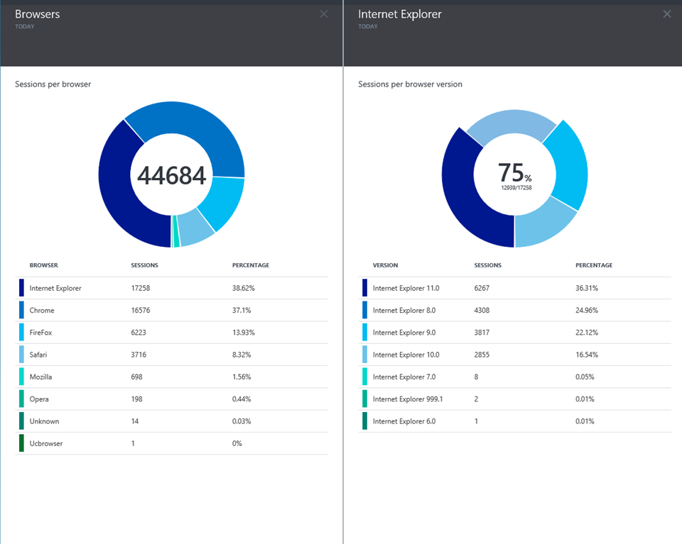
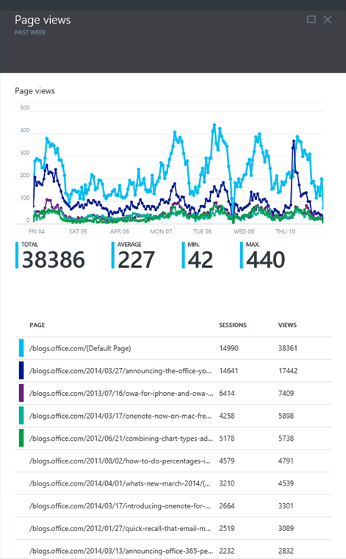
Application Insights

Slide 37
“and all that PaaS…”

Slide 38


Microsoft Azure Services
Access Control
Layer
AD
Multifactor
Authentication
BizTalk Services
Service Bus
CDN
Traffic Manager
Virtual Networks
Express Route
Integration
layer
API Mgmt
Mobile Services
Websites
Cloud Services
VM
Media Services
Notification Hubs
Scheduler
Automation
Application
layer
Blobs
Tables
Queues
SQL Database
Machine Learning
HD Insight
Caching
Backup and Recovery
StorSimple
Data Layer

Slide 39
$200 Azure Trial => aka.ms/azuretrial
Documentation => azure.com
Got 10 minutes? => friday.azure.com
Virtual Academy => aka.ms/cloudmva

Slide 40
Thank You!
@marc_gagne

Slide 42

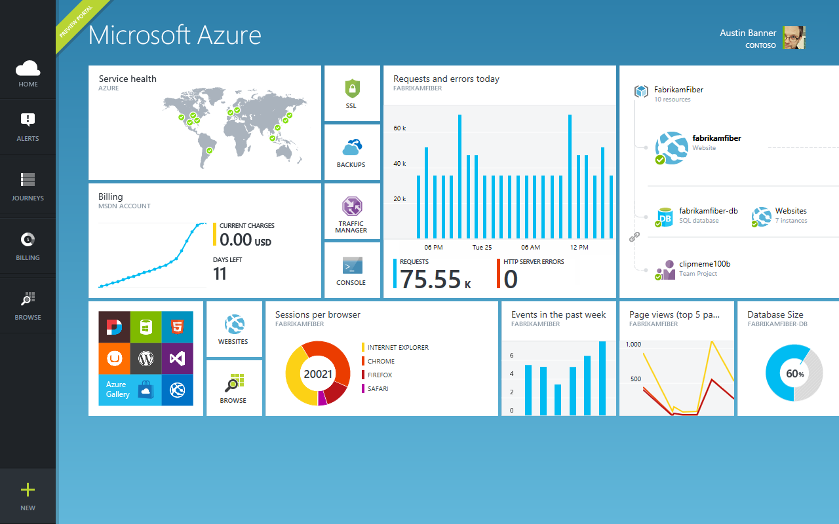
Get started
Visit azure.microsoft.com

Slide 43
Web Sites Service Architecture
Deployment
Server(s)
File Server
Publish Endpoint
Blob Storage
Application Database
Frontend (IIS ARR)
Microsoft Azure
Load Balancer
Metering
Runtime Database
API Endpoint

Slide 44
Debug Console (Kudu)
Environment
Debug Console
Diagnostics & Logs
Web Hooks
REST API
https://[website-name].scm.azurewebsites.net

Slide 45
Web Site
Web Site
Monaco
MSDeploy
Build/Upload Your Own
Kudu
Web Jobs
Gallery
Public Site Extensions
Private Site Extensions
Microsoft Azure Web Site

Slide 46
Customizing the Deployment
>: azure site deploymentscript –h
help:
help: Generate custom deployment script
help: Usage: site deploymentscript [options]
help:
help: Options:
help: --aspWAP <projectFilePath>
help: --aspWebSite
help: --node
help: --php
help: --python
help: --basic
Microsoft Azure Cross Platform Command-Line Tools

Slide 48
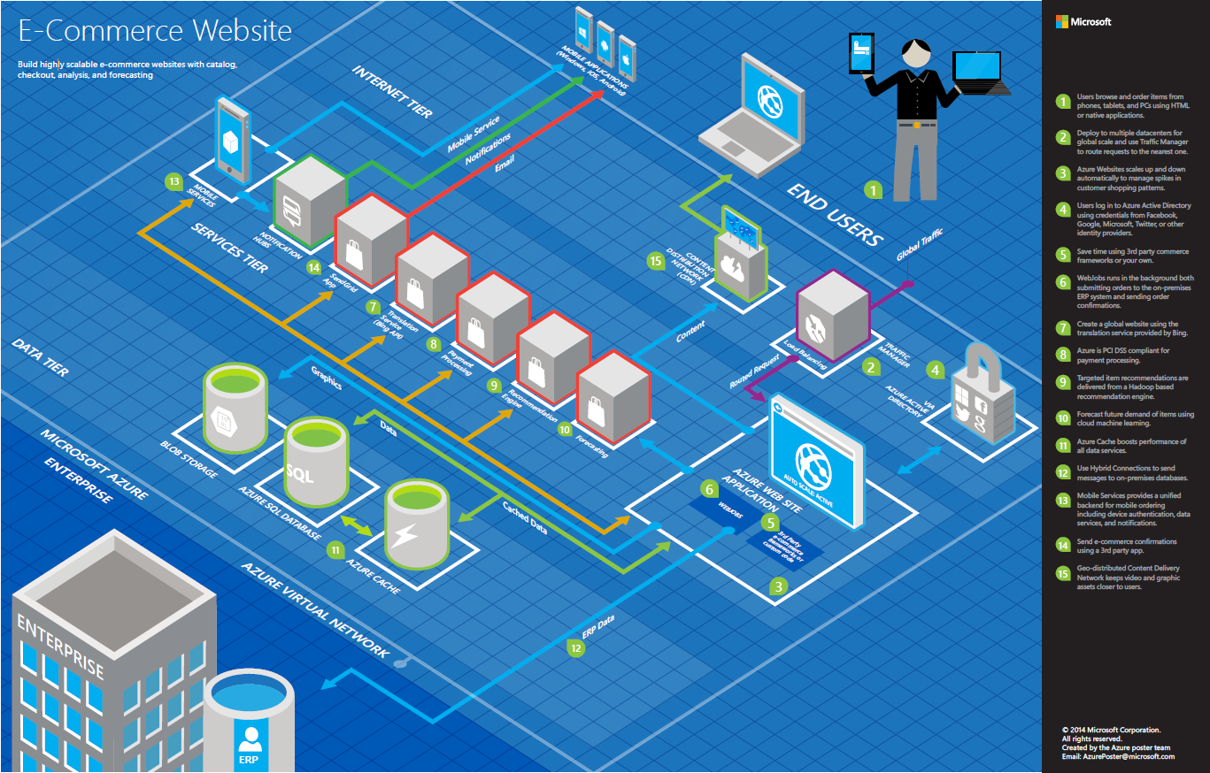

Slide 49
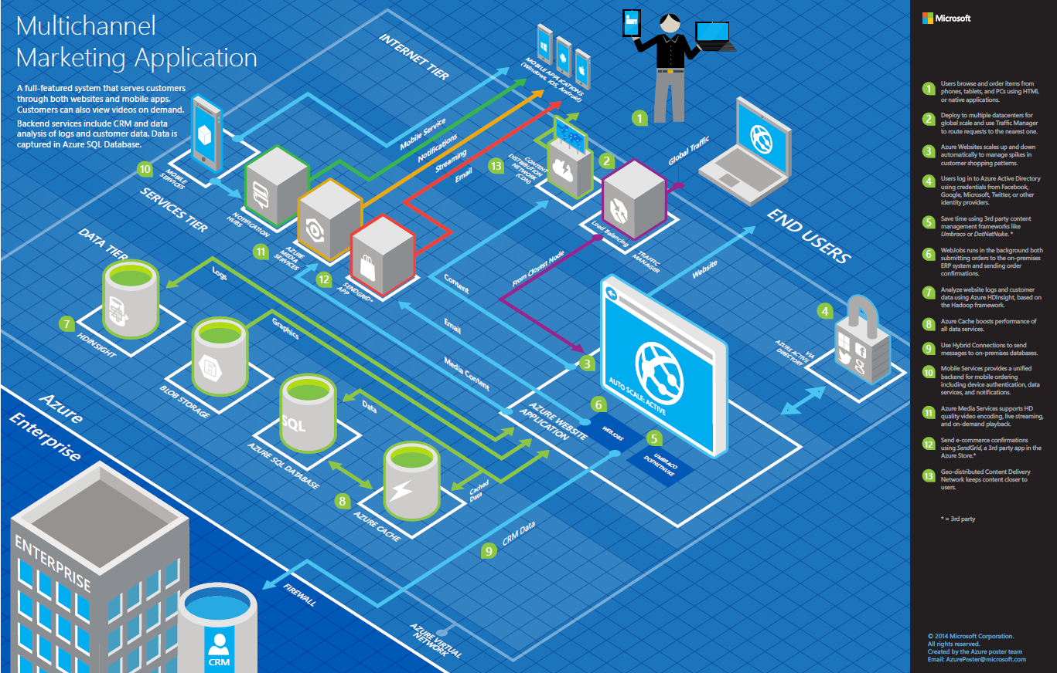

Slide 50
>57%
Greater than
1,000,000
>250k
Fortune 500 using Azure
Active websites
SQL Databases in Azure
>20
>1
TRILLION storage objects
>300
MILLION
AD users
MILLION
Developers registered with Visual Studio Online
>2
MILLION requests/sec
>13
BILLION
authentication/wk

Slide 51
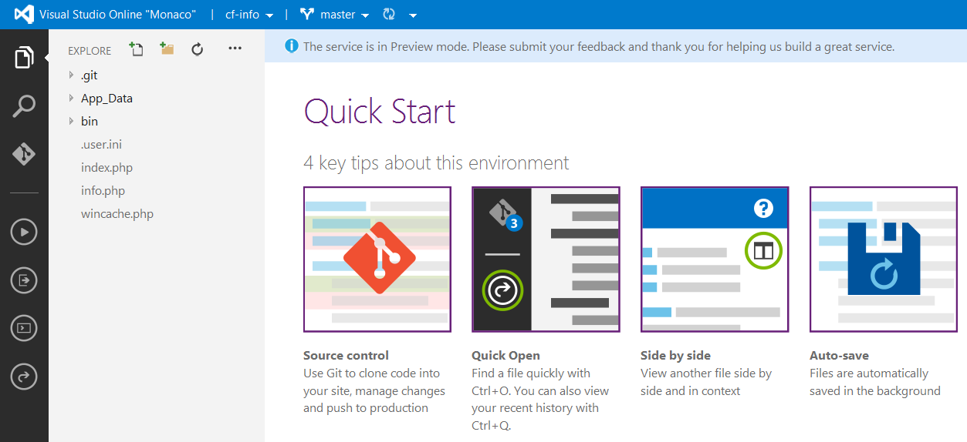
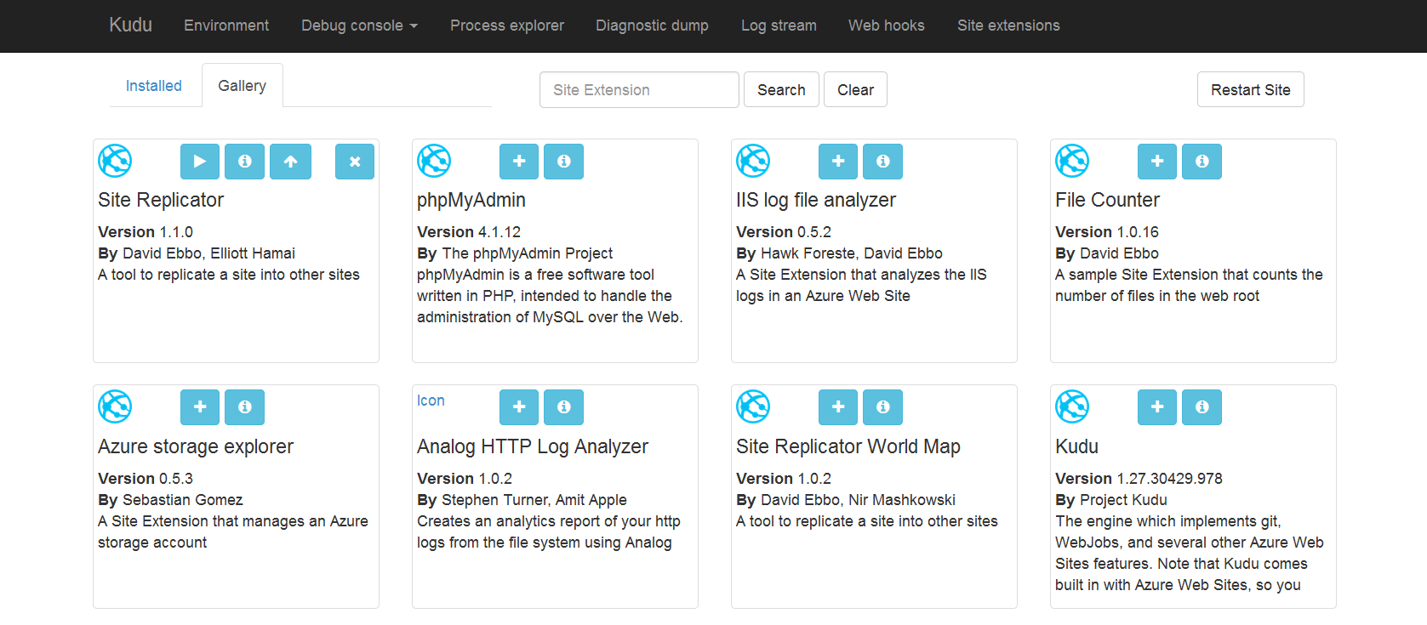
Site Extensions

Slide 52
WebSockets
Persistent Connection
Concurrent
Connections
5
35
350
Unlimited
Tier
Free
Shared
Basic / Standard
Premium

Slide 53


Web Hosting Plan
$
+
+
Azure Subscription
Pricing Tier
Geographic Region
Notes:
Web Hosting Plan is a scale unit for websites. It is comprised of a Geographic Region and a Pricing Tier within the same Azure Subscription. When you scale a site to either Basic or Standard all of the sites within the Web Hosting Plan will be placed on the same Virtual Machine.

